Slide 1

NOE for ETKDG
Rinikerlab
LPC, D-CHAB
Kajo Krummenacher
16. December 2020, Zürich

Slide 2
Agenda
Cyclic Peptides
ETKDG
NOE-ETKDG
Results
Conclusion & Outlook

Slide 3
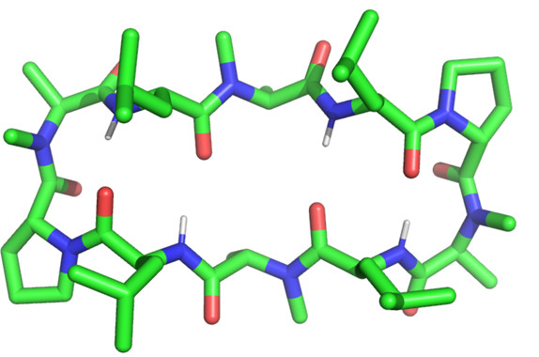
Cyclic Peptides
Range of 10 – 20 residues
Compared to classical small molecule drugs, they tend to have ^{[1]}:
higher bioavailability
higher stability in-situ
lower toxicity
more restricted binding options
→ of great interest for drug development
[1] Z. Qian et al, Curr Opin Chem Biol. 2017;38:80-86.

Slide 4
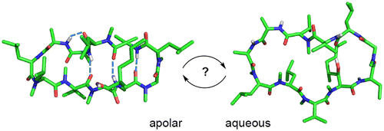
Example: Cyclosporin A ^{[1]}
Inhibitor, used as an immunosuppressant medication.
Closed: twisted sheet conformation with 4 H-bonds
Observed in crystal structure and CHCl₃
Allows membrane permeability
Open: conformation without H-bond
Preferred in H₂O and at the receptor
[1] J. Witek et al, J. Chem. Inf. Model. 2016, 56, 8, 1547–1562

Slide 5
ETKDG: Experimental-Torsion Knowledge Distance Geometry ^{[1]}
Distance geometry DG: Geometry theory assuming that all conformations of a molecule can be defined by geometric constraints.
Initial constraints from: - ideal bond lengths - ideal bond angles - ideal torsional angles → Experimental-Torsions ET
Basic knowledge K: - flatness of sp²-centers and aromatic rings - linear triple bonds
[1] S. Riniker and G. Landrum, J. Chem. Inf. Model. 2015, 55, 2562−2574

Slide 6
ETKDG: Working Principle
Initialize bounds matrix
Set topological bounds
Smoothing of bounds
Upper bounds: arbitrarily large
→ atom index
0 | 100 | 100 | 100 | 100 | 100
2.7 | 0 | 100 | 100 | 100 | 100
1.8 | 2.4 | 0 | 100 | 100 | 100
3.7 | 2.7 | 1.4 | 0 | 100 | 100
2.4 | 1.4 | 2.7 | 3.7 | 0 | 100
1.5 | 2.7 | 1.9 | 1.8 | 2.7 | 0
Use
ideal bond lengths
bond angles
torsional angles
basic knowledge
to
decrease upper bounds
and
increase lower bounds
Remark: Torsions from substructure search with torsional SMARTS patterns
Triangle Inequality:
→ atom index
B
A
C
AC ≤ AB + BC
AC ≥ | AB – BC |
Lower bounds: sum of VdW radii

Slide 7
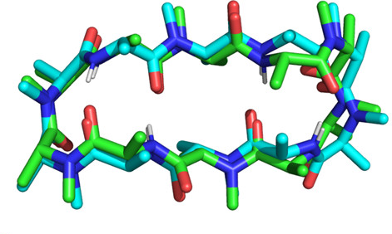
ETKDG: Working Principle
repeat
Random distance matrix
Metrization & Embedding
Optimization
0 | 4.8 | 4.2 | 4.2
2.7 | 0 | 5.3 | 3.9
1.8 | 2.4 | 0 | 5.3
3.7 | 2.7 | 1.4 | 0
Bounds Matrix
Transform D into N-1 dim metric space:
Metric Matrix G
Determine 4 largest eigenvalues and eigenvectors of G
Project into low dim space to obtain coordinates
Coords generally fit constraints well in a RMSE sense
Significant constraint violations possible
Refine by minimizing error function and torsional/distance potentials
 | 3.8 | 2.6 | 3.9
 |  | 5.1 | 2.2
 |  |  | 3.3
A possible Distance Matrix D
Accept new conformer if sufficiently different from existing set

Slide 8

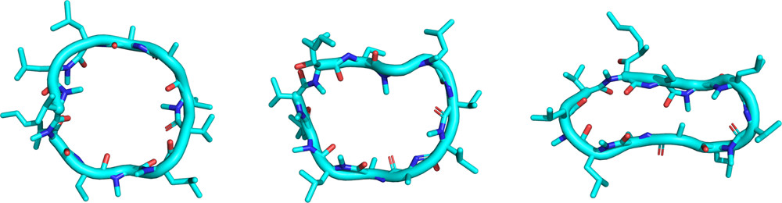
ETKDG: RDKit Developments Concerning Cyclic Peptides
Enforce cyclic eccentricity
Custom Pairwise Coulombic Interactions
Sereina & G. Landrum ^{[1]}
Shuzhe et al ^{[2]}
DG
ETKDG
ETKDGv3
NOE Restraints
ET
K
torsional-angle potentials for small aliphatic rings (≤8)
Modification of torsional SMARTS patterns for large rings (≥9)
SMARTS patterns for amides in macrocycles
[1] J. Chem. Inf. Model. 2015, 55, 2562−2574
[2] J. Chem. Inf. Model. 2020, 60, 2044−2058

Slide 9
NOE-ETKDG
Goals:
Use of NOE restraints to reduce search space and enable targeted conformer generation
Enable conformational analyses in water (high ε_{r}) and membrane (low ε_{r}) to assess permeability
Support non-standard amino acids (no residue templating)
Framework:
Open-source solution to be added to RDKit
Workflow should include other open-source software only (OpenMM, Open Forcefield…)

Slide 10
ETKDG Workflow
XPLOR: assign (resid 8 and name HB1 ) (resid 8 and name HG# ) 1.86 0.35 0.35
BioSym: 1:SER_4:HN 1:ASP_5:HN 1.900 5.000 1.00 1.00 1000.000
DIANA: 1 ARG+ HB3 2 ALA HN 3.48
table
or
.PDB
.SMI
NOE
Regex-based parser
C/N names
topology
restraints
unified RDKit mol rep
NOE-ETKDG
3D conformers
Refinement
Min
Sim
Ensemble Selection
e.g. .PDB
3D conformational ensemble

Slide 11
ETKDG Workflow
XPLOR: assign (resid 8 and name HB1 ) (resid 8 and name HG# ) 1.86 0.35 0.35
BioSym: 1:SER_4:HN 1:ASP_5:HN 1.900 5.000 1.00 1.00 1000.000
DIANA: 1 ARG+ HB3 2 ALA HN 3.48
table
or
.PDB
.SMI
NOE
regex-based parser
C/N names
topology
restraints
unified RDKit mol rep
NOE input
table/dataframe or regex-based extraction from text
NOE-ETKDG
3D conformers
Refinement
Min
Sim
Ensemble Selection
e.g. .PDB
3D conformational ensemble

Slide 12
ETKDG Workflow
XPLOR: assign (resid 8 and name HB1 ) (resid 8 and name HG# ) 1.86 0.35 0.35
BioSym: 1:SER_4:HN 1:ASP_5:HN 1.900 5.000 1.00 1.00 1000.000
DIANA: 1 ARG+ HB3 2 ALA HN 3.48
table
or
.PDB
.SMI
NOE
regex-based parser
C/N names
topology
restraints
unified RDKit mol rep
Unification
get C/N atom names from PDB
infer H atom names from their heavy atoms
match NOE H atoms to RDKit atoms 1. exact matches 2. fuzzy matches 3. expand (H@) and fuzzy match to equivalent set
NOE-ETKDG
3D conformers
Refinement
Min
Sim
Ensemble Selection
e.g. .PDB
3D conformational ensemble

Slide 13
ETKDG Workflow
XPLOR: assign (resid 8 and name HB1 ) (resid 8 and name HG# ) 1.86 0.35 0.35
BioSym: 1:SER_4:HN 1:ASP_5:HN 1.900 5.000 1.00 1.00 1000.000
DIANA: 1 ARG+ HB3 2 ALA HN 3.48
table
or
.PDB
.SMI
NOE
regex-based parser
C/N names
topology
restraints
unified RDKit mol rep
NOE
H 94
108 H
NOE-ETKDG
3D conformers
Refinement
Min
Sim
0 | … | … | …
… | 0 | … | 7.5
… | … | 0 | …
… | … | … | 0
0 | … | … | …
… | 0 | … | 4.9
… | … | 0 | …
… | … | … | 0
Ensemble Selection
e.g. .PDB
3D conformational ensemble

Slide 14
ETKDG Workflow
XPLOR: assign (resid 8 and name HB1 ) (resid 8 and name HG# ) 1.86 0.35 0.35
BioSym: 1:SER_4:HN 1:ASP_5:HN 1.900 5.000 1.00 1.00 1000.000
DIANA: 1 ARG+ HB3 2 ALA HN 3.48
table
or
.PDB
.SMI
NOE
regex-based parser
C/N names
topology
restraints
unified RDKit mol rep
Refinement
minimization or MD of conformers with openMM - instantaneous restraints (2000 kJ mol⁻¹ nm⁻²) - partial charges generated with mlddec ^{[1]} - vacuum or implicit solvent
minimization with ANI potential ^{[2]}
NOE-ETKDG
3D conformers
Refinement
Min
Sim
Ensemble Selection
e.g. .PDB
3D conformational ensemble
[1] P. Bleiziffer et al, J. Chem. Inf. Model. 2018, 58, 3, 579–590
[2] X. Gao et al, J. Chem. Inf. Model. 2020, 60, 7, 3408–3415

Slide 15
ETKDG Workflow
XPLOR: assign (resid 8 and name HB1 ) (resid 8 and name HG# ) 1.86 0.35 0.35
BioSym: 1:SER_4:HN 1:ASP_5:HN 1.900 5.000 1.00 1.00 1000.000
DIANA: 1 ARG+ HB3 2 ALA HN 3.48
table
or
.PDB
.SMI
NOE
regex-based parser
C/N names
topology
restraints
unified RDKit mol rep
Ensemble Selection
there might not be one correct structure
select a small subset s.t. the weighted average fulfills all NOEs
NOE-ETKDG
3D conformers
Refinement
Min
Sim
Ensemble Selection
e.g. .PDB
3D conformational ensemble

Slide 16
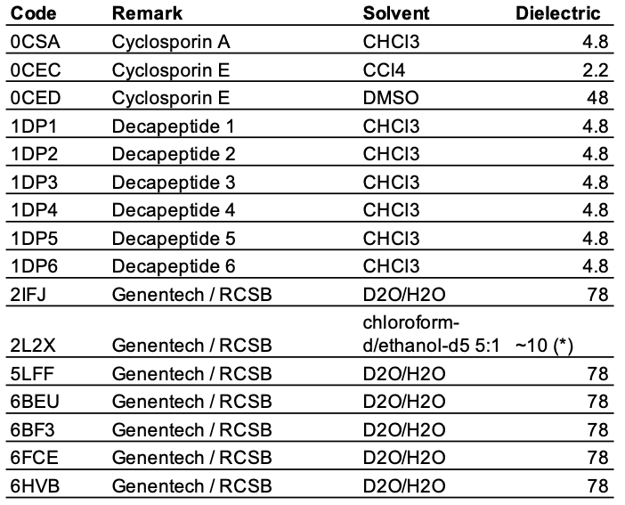
Test Cases: Overview

Slide 17
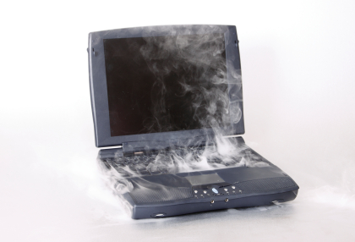
Clarifications and Terminology
Number of conformers:
5400 for ETKDG and minimization techniques
540 for 1 ns simulations
54 for 5 ns simulations
Implicit solvent min/sim according to dielectric of NOE solvent
All min/sim with constraints (except ANI potential)
rbRMSD: Root-mean square deviation of ring and beta-atoms between best conformer and first reference

Slide 18
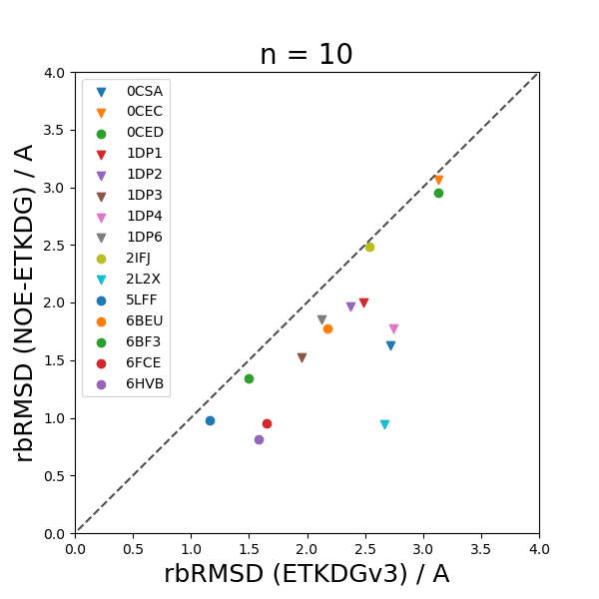
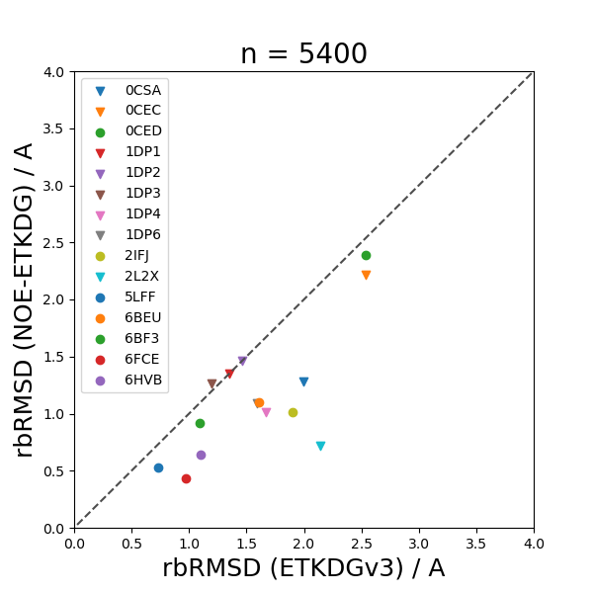
rbRMSD: ETKDGv3 v NOE-ETKDG

Slide 19
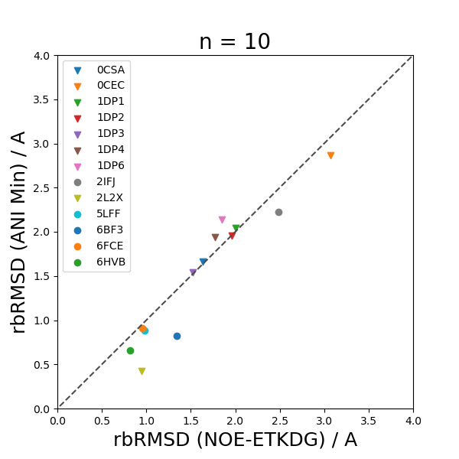
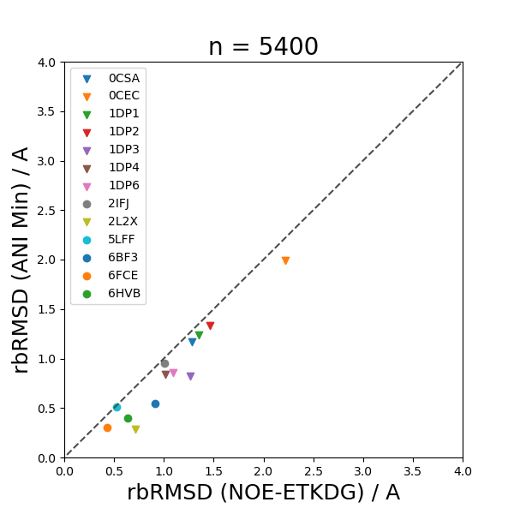
rbRMSD: NOE-ETKDG v ANI Min

Slide 20
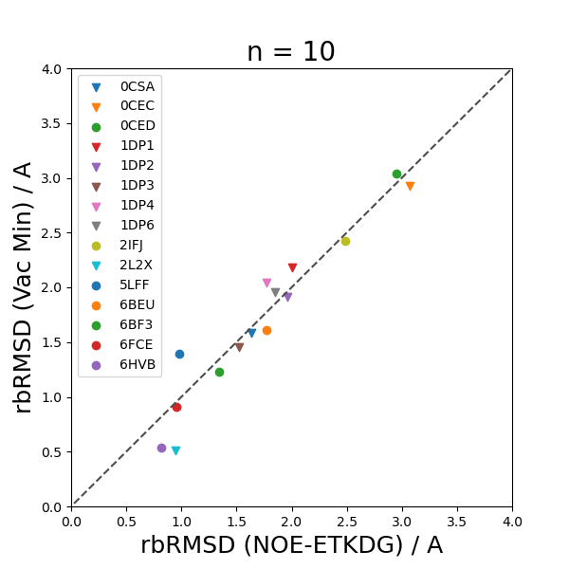
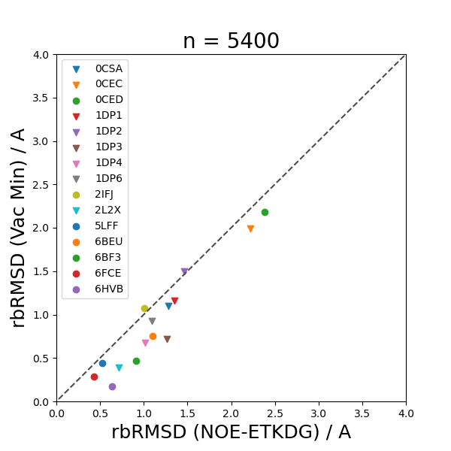
rbRMSD: NOE-ETKDG v Vac Min

Slide 21
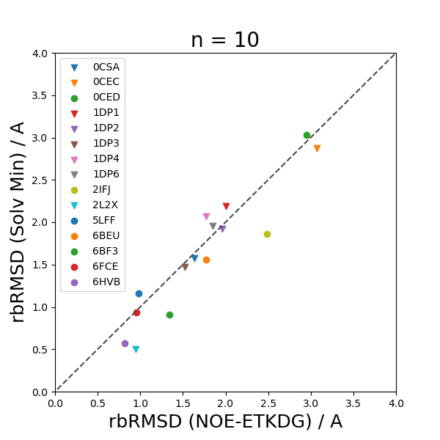
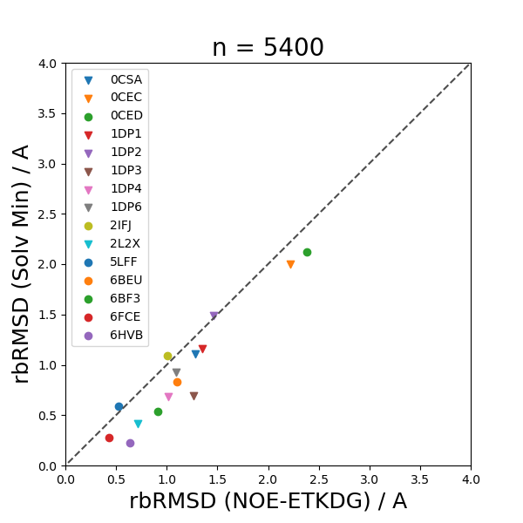
rbRMSD: NOE-ETKDG v Solv Min

Slide 22
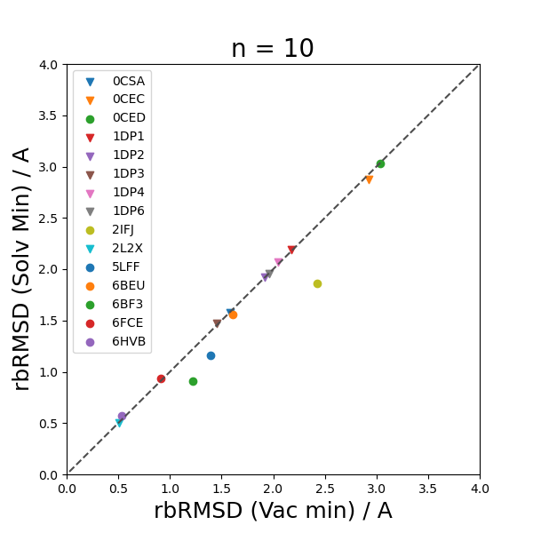
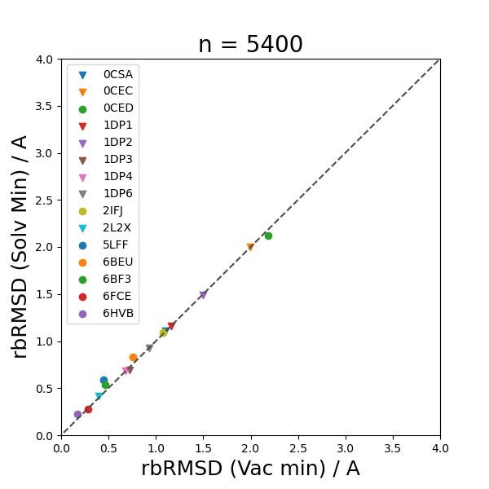
rbRMSD: Vac Min v Solv Min

Slide 23
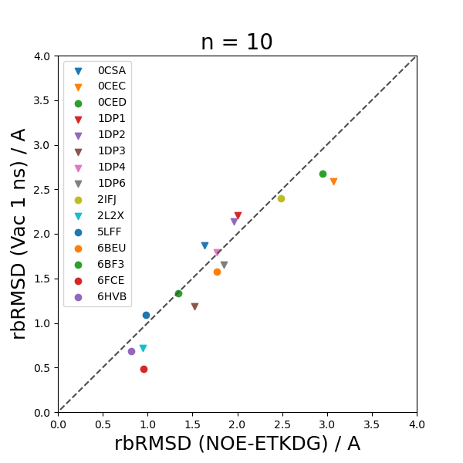
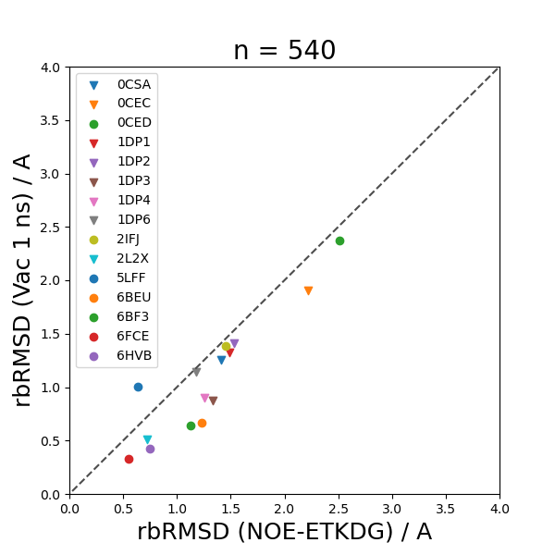
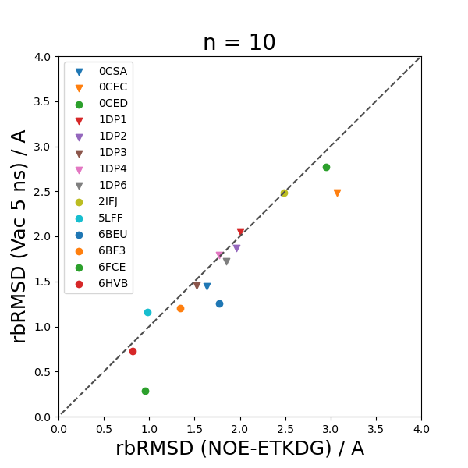
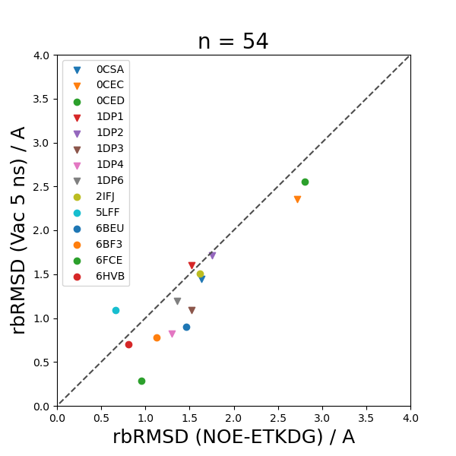
rbRMSD: NOE-ETKDG v Vac Sim

Slide 24
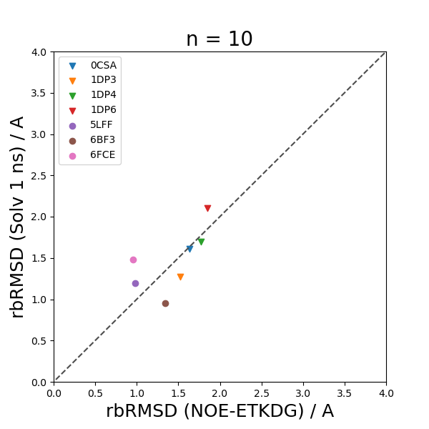
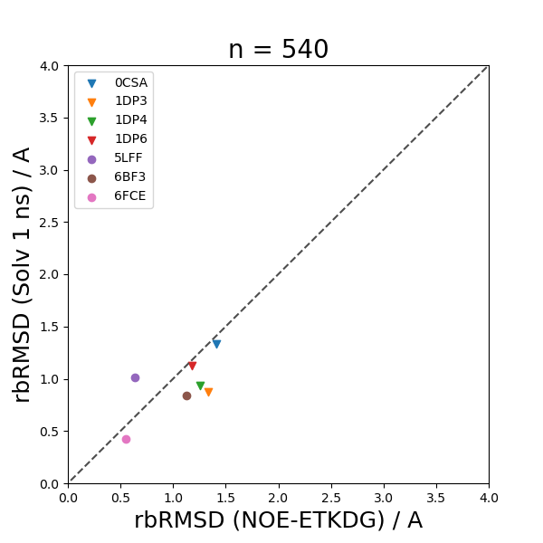
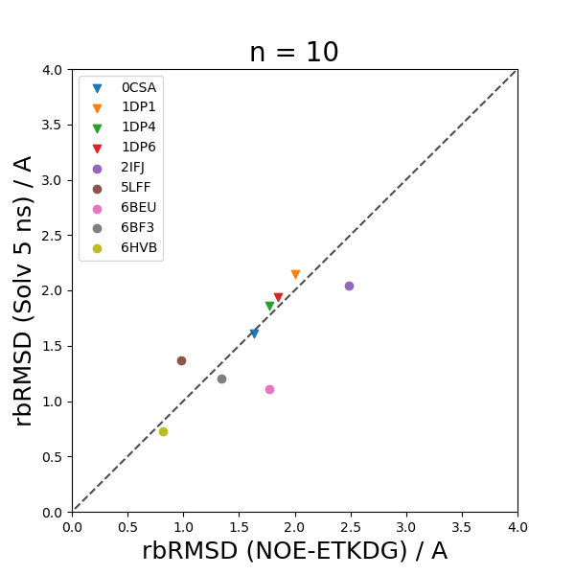
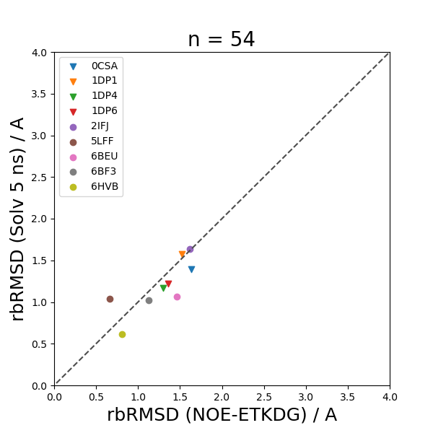
rbRMSD: NOE-ETKDG v Solv Sim

Slide 25
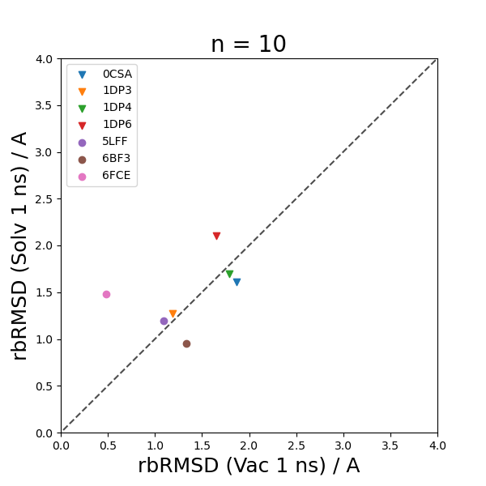
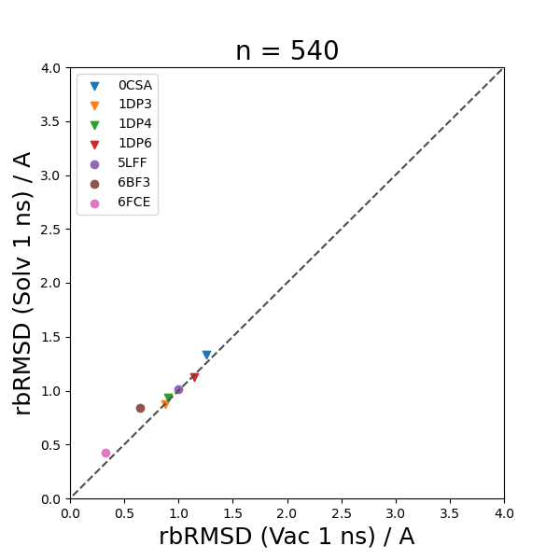
rbRMSD: Vac Sim v Solv Sim

Slide 26
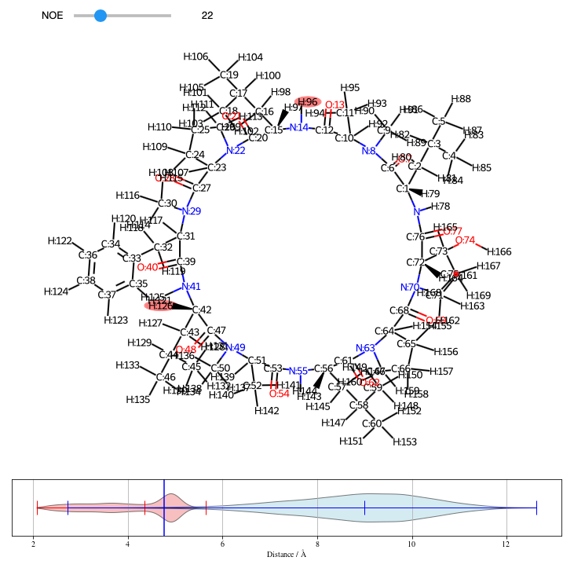

NOE Pairs: Distance Distributions
--> Live demo, added pic for archive

Slide 27
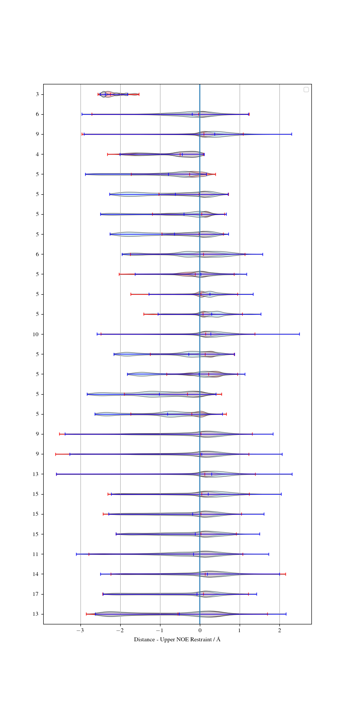
NOE Pairs: Broader Distance Distributions after Minimization
NOE-ETKDG
Vac Min

Slide 28
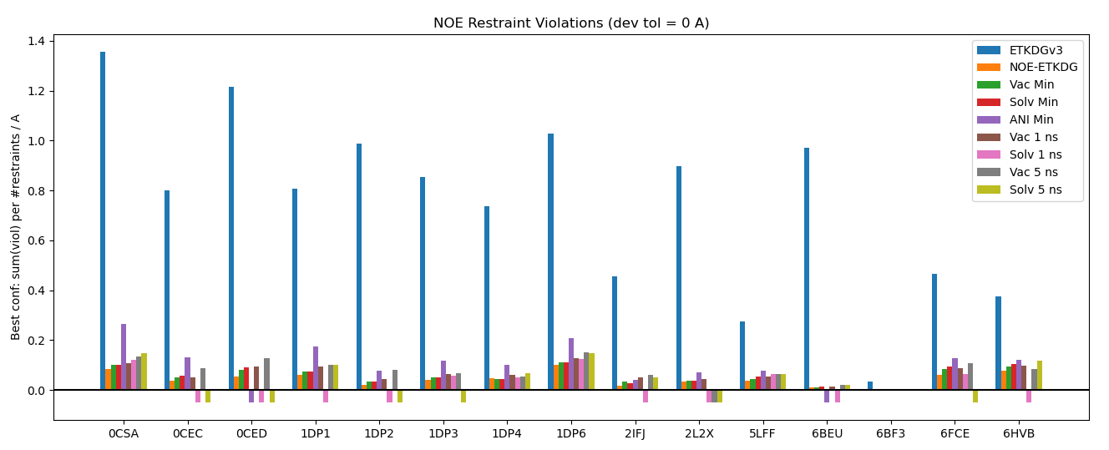
Violations of NOE Restraints

Slide 29
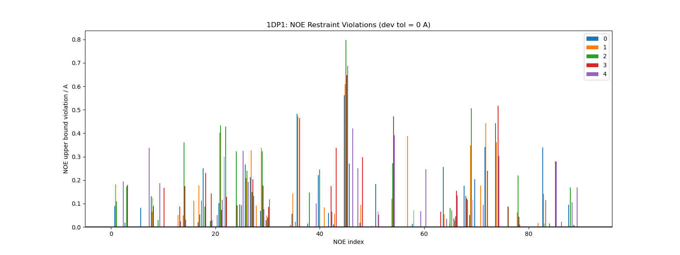
Single Molecule NOE Index graph

Slide 30
Conclusions
NOE-ETKDG effectively shrinks the search space to enable targeted conformer generation with restraints.
Different minimization schemes are a fast way to improve rbRMSD.
Simulations of such macrocycles is already computationally expensive and adds (as done so far) little value
Minimization/Simulation (as done so far) add little value w.r.t NOE restraint violations, but might still help due to increased variation.

Slide 31
Outlook
More test cases to increase robustness
Time-averaged NOE restraints for openMM simulations
Find a good and fast charge generator for different dielectrics
Open-source/RDKit based ensemble selection tool

Slide 32
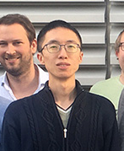
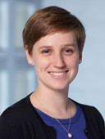
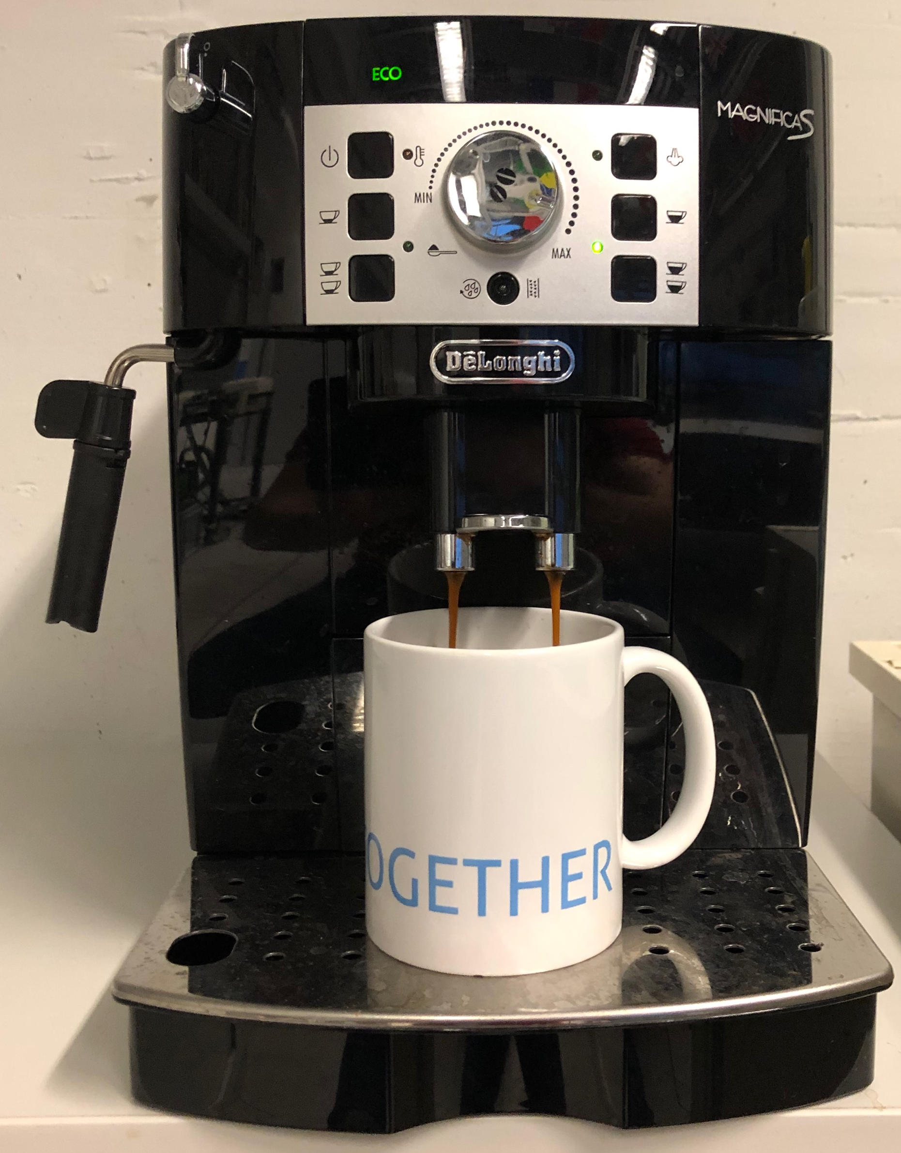
Final Remarks
Genen
tech
CCG
CSMS

Slide 33


